Slide 1


AI-Driven Software Development with Xebia
Reimagine Software Development
with Xebia ACE– AI Native
Engineering Solution

Slide 2
Shifting Software Development Paradigms
AI is fundamentally reshaping how software is developed
1
Transformative Potential
AI has the potential to solve one of software engineering’s biggest challenges: delivering more value faster despite ever-growing complexity that slows teams down.
2
Barriers to Adoption
Adoption remains limited - AI is mostly used for isolated tasks. Skills gaps, weak engineering foundations, and security concerns are holding back real change and fueling excessive caution.
By 2026, AI-driven SDLC tools will enable enterprises to release software 40% faster while maintaining quality. Source: Gartner 2025
3
Elusive ROI
To unlock true value, AI must go beyond code. Applying it across the entire SDLC, improving engineering practices, and tracking measurable impact are key to meaningful transformation.
2

Slide 3
Seizing
the Opportunity
Unlocking AI's full value requires deliberate, engineering-led adoption.
1
End-to-end SDLC Automation
AI’s potential goes far beyond code generation. With the right approach, teams can apply AI across the full software development lifecycle — from requirements analysis and architecture to testing, deployment, and continuous improvement. This is how you scale beyond isolated use cases.
2
Solid Engineering Foundation
Organizations with mature engineering practices — including automated pipelines and testing, review process, robust quality assurance and continuous monitoring — are best positioned to turn AI into a strategic advantage. Without it, automation amplifies chaos, not productivity.
Programming is the immediate act of producing code. Software engineering is the set of policies, practices and tools that are necessary to make that code useful for as long as it needs to be used and allow collaboration across a team.
3
Proof-Based Adoption
Today’s leaders face a dilemma: FOMO on AI gains vs. real concerns around ROI, confidentiality, and quality. The solution? A pragmatic, outcome-driven approach. Start where the value is proven, with clear goals, measurable impact, and guardrails in place. That’s how AI adoption becomes sustainable.
3

Slide 4



AI in Software Development Potential vs Actual Realization
Widespread Uptake, Variable Integration
Quality & Efficiency Gains
Strategic Limitations & Friction
Maturity Stage
From Experimentation to Early Scaling
55%
20-50%
~26%
Widespread Experimentation
Tool adoption is nearly universal among developers
of companies have truly embedded AI into their workflows (McKinsey, as of 2023)
Estimated speed increase
in development teams
of companies have scales
AI beyond pilot phases (BCG)
30%
Deloitte
GitHub’s enterprise
Variable Strategic Embedding
Some companies scale; many remain in pilot phases with limited governance.
highlights risks around design, governance, and quality
assurance gaps
survey points to governance, policy, and standardization as key blockers to adoption
of developers actively advocate for AI tools (GitHub)
90%
DORA’s 2024 State
Organizational Friction
Policy, data governance, and compliance challenges slow full maturity.
of projects may introduce AI into the SDLC in the next two years, but level of adoption vary
of DevOps Report shows that AI improves flow and job satisfaction, but warns of delivery setbacks when governance is lacking

Slide 5






Barriers to AI Adoption in Software Development Lifecycle
Requirements & Planning
Quality Engineering
Lack of structured, standardization project information
Ambiguity and inconsistency in natural-language inputs
Insufficient or biased training data
High complexity in test environment configuration
Automation silos between unit, integration, and UI tests
Challenges
Architecture & Design
Deployment & Release
Inability in capturing deeper architectural context
Limited or no availability of tools / frameworks in this segment
Operational resistance to AI-assisted deployment decisions
Lacking in understanding complex & custom CI/CD pipelines
UI & UX Design
Maintenance & Support
Tension between creativity and automation
Lack of contextual relevance in generated outputs
Gaps in accessibility and inclusive design support
Low trust and adoption among design teams
Alert fatigue & noise. AI often increases volume instead of prioritizing
Difficulty correlating logs, metrics, and traces into meaningful diagnostics
Limited integration with ITSM platforms and workflows

Slide 6


AI-Driven Software Development with Xebia
Xebia AI Native Engineering Solution

Slide 7
Introducing Xebia – AI Native Engineering Solution
Xebia solution provides a pragmatic, results-driven approach to software engineering and digital transformation.
End-To-End Mastery
Composable & Seamlessly Interoperable
AI-Enhanced Engineering Teams
Real productivity in software delivery isn't about optimizing single tasks but streamlining the entire SDLC—like a high-efficiency manufacturing line. AI enables holistic automation across all phases, minimizing manual toil and cognitive overload.
AI evolves rapidly, and rigid systems can’t keep up. A flexible, modular SDLC orchestration ensures seamless integration of AI-driven accelerators—whether custom-built or COTS—future-proofing your software delivery.
AI shifts engineering teams from executing repetitive tasks to orchestrating intelligent automation, ensuring higher efficiency, improved quality control, and reduced burnout—allowing teams to focus on innovation, not process execution.
No empty promises – just measurable impact.
AI that amplifies, not replaces, engineering expertise.
Scalable, structured workflows that drive real business outcomes.
7

Slide 8








AI Native Software Engineering Solution across SDLC
AI Powered Efficiency Drives Productivity across SDLC
Requirements
& Planning
Architecture
& Design
UI & UX
Development
Deployment
& Release
Testing
Maintenance
& Support
Requirements Elicitation
Requirements Elaboration
Planning
Integration with JIRA
C4 Model Architecture
Diagrams & API Specs
High Level Design
Low Level Design
Documentation
PRD
Style Guide
Screen Listing
Wireframes
UX Design
Clickable Prototype
Front End Code
Generation
Project Scaffolding
Skeleton Code
DB Scripts
Documentation
Code Comprehension
CI/CD optimization
Deployment risk scoring
Rollback/blue–green gate options
Vulnerability Checks
Test Design
Test Case Creation
Test Automation
Test Data Generation
Unit Test Generation
Log/trace corrélation & root-cause analysis
Alert triaging & ticket suggestions
Auto-remediation and predictive maintenance
Productivity Increase
Productivity Increase
Productivity Increase
Productivity Increase
Productivity Increase
Productivity Increase
Productivity Increase
30-50%
30-40%
30-40%
20-25%
10-25%
30-60%
15-25%
Notes:
Architecture & Design should be 2nd building block
Requirements & Planning: Requirements Elicitation → Requirements Elaboration → Planning → Integration with Jira
Architecture & Design: C4 Model Architecture → Diagrams (C1, C2, C3, C4, Sequence, Deployment view, Data Model) & API Specs → High Level Design → Low Level Design → Documentation → Integration with Confluence
UI & UX: PRD → Style Guide → Screen listing → Wireframes → UX Design → Clickable Prototype → UI Frontend Code Generation
~Development: HLD + LLD → Project Scaffolding → Skeleton Code → Github CoPilot / Amazon Q / Tab 9 / OpenAI Codex → Synk
~Deployment & Release: Incorporate Harness / Spinnaker
Testing: Test Design → Test Case creation → Test Automation → Test Data Generation
~Maintenance & Support

Slide 9






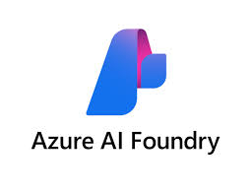
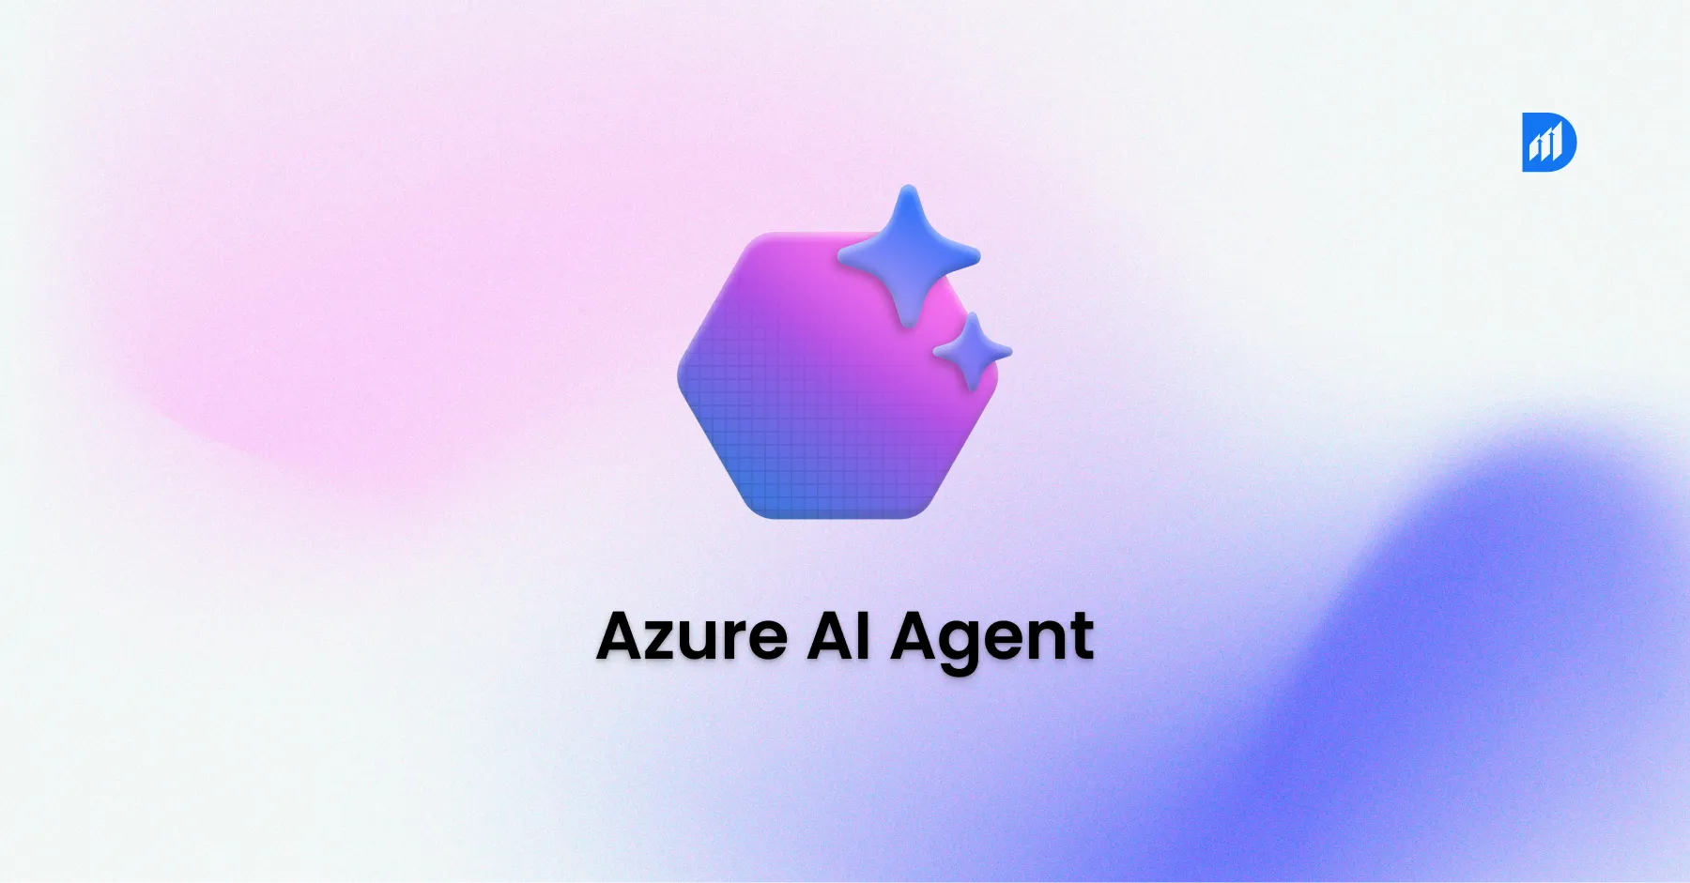








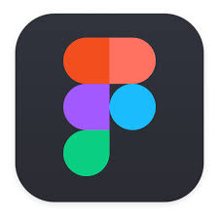

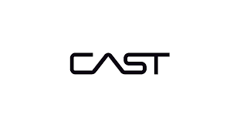
Xebia AI Infused SDLC Framework (Azure)
Our solution unifies fragmented SDLC tools into a composable, AI-powered platform that streamlines every phase, empowers engineering teams, and delivers measurable outcomes.
Platform
AI-native Software
Engineering Platform
v
MCP Clients
v
Projects
Repo’s
Requirements
& Planning
Analyze → Contextualization
Requirements
Elicitation
Elaboration
Epics & Stories
MVP Planning
Orchestrator
PRD &
UI Interfaces
Style Guide
Wireframes
Clickable
Prototypes
UX Design
Knowledge Base
C4 Architecture
Model
Architecture
& Design
Embeddings
HLD / LLD
API Specs
Diagrams &
Documentation
Development
Scaffolding
FE Code
Skeleton
Code
DB Scripts
Testing
Redis
Postgres
SQL
RAG
Test Design
Test Cases
Test
Automation
Test Data
OpenAI Codex
tabnine
Amazon Q
GitHub Copilot
Harness
Spinnaker
Jenkins X

Slide 10
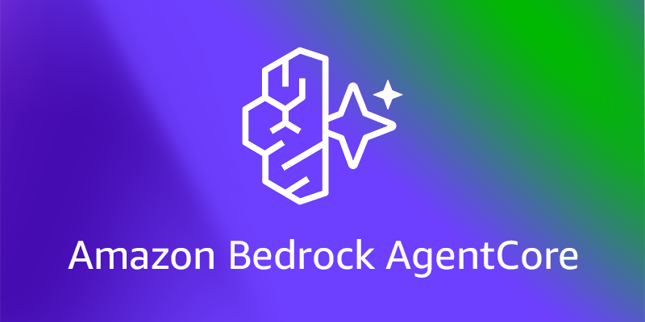
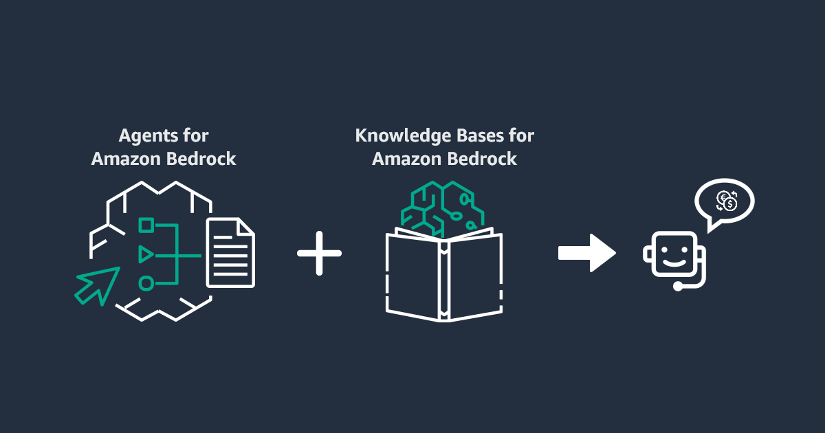


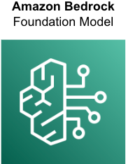
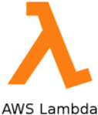



Xebia AI Infused SDLC Framework (AWS)
Our solution unifies fragmented SDLC tools into a composable, AI-powered platform that streamlines every phase, empowers engineering teams, and delivers measurable outcomes.
Platform
AI-native Software
Engineering Platform
v
MCP Clients
v
v
Projects
Repo’s
Requirements
& Planning
Analyze → Contextualization
Requirements
Elicitation
Elaboration
Epics & Stories
MVP Planning
Orchestrator
PRD &
UI Interfaces
Style Guide
Wireframes
Clickable
Prototypes
UX Design
Knowledge Base
C4 Architecture
Model
Architecture
& Design
Embeddings
HLD / LLD
API Specs
Diagrams &
Documentation
Development
Scaffolding
FE Code
Skeleton
Code
DB Scripts
Testing
Elasticache
RAG
Test Design
Test Cases
Test
Automation
Test Data
OpenAI Codex
tabnine
Amazon Q
GitHub Copilot
Harness
Spinnaker
Jenkins X

Slide 11



Xebia AI Infused SDLC Framework (Open Source)
Our solution unifies fragmented SDLC tools into a composable, AI-powered platform that streamlines every phase, empowers engineering teams, and delivers measurable outcomes.
Platform
AI-native Software
Engineering Platform
v
MCP Clients
v
Projects
Repo’s
Requirements
& Planning
Analyze → Contextualization
Requirements
Elicitation
Elaboration
Epics & Stories
MVP Planning
Orchestrator
PRD &
UI Interfaces
Style Guide
Wireframes
Clickable
Prototypes
UX Design
Knowledge Base
C4 Architecture
Model
Architecture
& Design
Embeddings
HLD / LLD
API Specs
Diagrams &
Documentation
Quadrant DB
Development
Postgres
SQL
Scaffolding
FE Code
Skeleton
Code
DB Scripts
Testing
RAG
Test Design
Test Cases
Test
Automation
Test Data
OpenAI Codex
tabnine
Amazon Q
GitHub Copilot
Harness
Spinnaker
Jenkins X

Slide 12









Our Partners
Xebia is partnering with Harness to redefine software delivery, integrating true agile platform engineering with AI-driven automation to empower development teams and accelerate business transformation.
Rhino.ai enables enterprises to unlock business value through scalable machine learning solutions, intelligent automation, and advanced analytics across the enterprise lifecycle.
IBM Watson offers AI-powered solutions that help businesses automate processes, gain insights from data, and make smarter decisions. From natural language understanding to predictive analytics, Watson enables enterprise-grade AI at scale.
Xebia is Global GitHub Partner of the Year 2024-2025 and GitHub’s first verified partner in Europe.
CAST, the leader in Software Intelligence, empowers enterprises with AI-driven insights into application health, architecture, and cloud readiness. Through our partnership, we leverage CAST’s “MRI for Software” capabilities to accelerate modernization, reduce technical debt, and drive smarter transformation at scale.

Slide 13

AI-Driven Software Development with Xebia
Features & Offerings Reflections through days
in the lives of AI-enhanced roles

Slide 14

A day in the life of AI-powered Business Analyst, Product Owners and Scrum Masters
Potential Productivity Increase: 30-50%
Platform Features
Key Metrics Impacted
Typical Daily Activities
Requirements Elicitation
Requirements Elaboration
Planning
Integration with JIRA, Azure DevOps, Clickup and more
Faster time to market
Higher requirements quality
Fewer iterations and rework
Shorter planning cycles
Improved team alignment
Better resource utilization
Continuous process improvement
Capturing requirements during morning standups
Conducting requirements elicitation sessions
Aligning stakeholders and prioritizing scope
Collaborating with design and development teams
Tracking and reporting project progress
Activities Enhanced with the Xebia AI Native Software Engineering Solution
Leverages Multimodal Data Ingestion and NLP Understanding to process documents, chats, emails, and transcripts
Requirement Mining and Requirement Structuring turn raw inputs into clear, categorized requirements
Planning & Prioritization and Gap Analysis tools help organize workstreams based on business impact
Feedback Loop and Memory & Context Management enable real-time validation and ongoing alignment
Image Analysis & Feature Extraction connects requirements to code; Tool Integration ensures end-to-end coverage

Slide 15

A day in the life of AI-powered Software Architects and Leads
Potential Productivity Increase: 30-40%
Platform Features
Key Metrics Impacted
Typical Daily Activities
C4 Model Architecture
Diagrams & API Specs
High Level Design
Low Level Design
Documentation
Integration with Confluence
Faster diagram creation
Shorter document cycles
Better alignment with standards
Broader artifact coverage
Reviewing requirements
Designing system & component architecture
Defining APIs & interfaces
Collaborating with design and development teams
Producing HLDs (High-Level Designs) & LLDs (Low-Level Designs)
Documenting in Confluence
Participating in design reviews
Activities Enhanced with the Xebia AI Native Software Engineering Solution
Applies Multimodal Ingestion and NLP to extract and interpret needs from code, stories, and docs
Enables Automated Architecture Understanding, Domain Awareness, and Diagram Generation to instantly create C4 views
High-Level and Low-Level Design Generators produce structured design artifacts based on traceable inputs
Code-to-Architecture Traceability connecting requirements, APIs, and system logic for full alignment
Uses Collaboration Support and Memory Management to capture context and support iterative design reviews

Slide 16

A day in the life of AI-powered UX Designers and UI Engineers
Potential Productivity Increase: 30-50%
Platform Features
Key Metrics Impacted
Typical Daily Activities
PRD
Style Guide
Screen Listing
Wireframes
UX Design
Clickable Prototype
UI FE Code Generation
Fewer iterations, faster delivery
Improved accessibility
Higher component reuse
Quicker developer handoff
More consistent visuals
Lower usability issues
Reviewing product requirements
Creating wireframes and layouts
Applying visual design and style guidelines
Building interactive, clickable prototypes
Handing off designs to developers
Activities Enhanced with the Xebia AI Native Software Engineering Solution
Uses Multimodal Data Ingestion and Generate PRDs to extract key UX needs from documents, stories, and notes
Map User Flows and Enumerate Screens from parsed requirements and context
Generates ASCII wireframes and Responsive Layouts aligned with brand and usability standards
Builds Interactive Prototypes and leverages the Components Catalog and Style Guide for visual consistency
Exports to Figma and integrates Feedback for continuous refinement and faster collaboration

Slide 17

A day in the life of AI-powered Developers
Potential Productivity Increase: 15-30%
Platform Features
Key Metrics Impacted
Typical Daily Activities
HLD + LLD
Project Scaffolding
Skeleton Code
Auto-complete, code gen, refactoring
Documentation
Large-scale code migration assistance
Unit tests generation
Reduced time to first commit
Faster feature development
Lower code rework and review cycles
Improved code quality and consistency
Increased reuse of components
Better traceability
Understanding design specifications
Setting up the development environment
Implementing new features
Writing and optimizing code
Modernizing or migrating legacy code
Writing Unit tests
Activities Enhanced with the Xebia AI Native Software Engineering Solution
Leverages HLD + LLD outputs directly linked from upstream architecture and requirements
Uses Project Scaffolding to auto-generate boilerplate structures and base configurations
Provides Skeleton Code aligned with design standards, to enable rapid development
Employs Auto-complete, code generation, and refactoring features to support faster, cleaner development
Uses Large-scale Code Migration Assistance to update syntax, patterns, or tech stacks automatically

Slide 18

A day in the life of AI-powered Release Managers and DevOps Engineers
Potential Productivity Increase: 10-25%
Platform Features
Key Metrics Impacted
Typical Daily Activities
CI/CD optimization
Deployment risk scoring
Rollback/blue–green gate options
Higher release success rate
Improved deployment confidence
Reduced rollback incidents and downtime
Streamlined gate approvals and auditability
Better coordination across Dev, QA & Ops
Planning and scheduling releases
Assessing release readiness and risks
Coordinating deployments
Managing rollback strategies
Tracking release status and incidents
Activities Enhanced with the Xebia AI Native Software Engineering Solution
Uses CI/CD Optimization to streamline pipeline setup and automate release workflows
Leverages Deployment Risk Scoring to assess feature stability, test coverage, and unresolved issues
Orchestrates rollouts using automated pipelines with built-in approval gates and validations
Utilizes blue–green gate options and smart rollback triggers to reduce disruption
Monitors pipeline health and applies risk intelligence to enable proactive responses and informed rollback decisions

Slide 19

A day in the life of AI-powered Quality Engineers
Potential Productivity Increase: 30-60%
Platform Features
Key Metrics Impacted
Typical Daily Activities
Test Design
Test Case Creation
Test Automation
Test Data Generation
Reduced test design & execution time
More test coverage & edge case detection
Faster regression cycle times
Reduced manual QA effort
Quicker test updates
Improved requirement-to-test traceability
Designing test scenarios
Creating and managing test cases
Automating test execution
Generating test data
Validating test coverage and quality
Activities Enhanced with the Xebia AI Native Software Engineering Solution
Parses requirements to auto-generate test designs aligned with user intent and business logic
Uses AI-powered Test Case Generator to create executable, human-readable scenarios in formats like Gherkin
Converts test cases to automation-ready code using Test Code Generator, compatible with frameworks like Selenium, Cypress, and Junit
Automatically produces relevant test data based on field types, edge cases, and validation rules
Ensures traceability and alignment across requirements, tests, and defects; highlighting gaps automatically

Slide 20

A day in the life of AI-powered Technical Support Engineer
Potential Gains: ~50% fewer incidents, 15–20% faster triage and resolution
Platform Features
Key Metrics Impacted
Typical Daily Activities
Log/trace correlation & root-cause analysis
Alert triaging & ticket suggestions
Auto-remediation and predictive maintenance
Faster MTTD, reduced MTTR
Improved root cause accuracy
Fewer miscategorized and misrouted tickets
Increased auto resolution rate
Lower incident recurrence
Higher support team productivity
Monitoring and reviewing incidents
Triaging and categorizing tickets
Investigating and resolving issues
Executing remediation steps
Collaborating with development and infrastructure teams
Activities Enhanced with the Xebia AI Native Software Engineering Solution
Performs log/trace correlation and identifies likely root causes using AI-driven analysis
Leverages alert triaging & ticket suggestion engine to auto-prioritize and pre-fill incident details
Provides contextual insights and resolution paths based on historical patterns and knowledge base
Enables auto-remediation for recurring issues and applies predictive maintenance strategies to prevent incident recurrence
Shares structured findings and recommended actions via integrated ticketing platforms (e.g., JIRA, ServiceNow)

Slide 21
AI is Rewriting the Rules
of Software Delivery. Xebia Makes it Real
1
From Fragmented Tooling to Integrated AI-powered Engineering
From fragmented tooling to full-lifecycle AI-infused engineering — powered by Xebia – AI-Native Software Engineering Solution
Others patch productivity gaps. Xebia delivers full-lifecycle transformation with AI embedded across your SDLC.
2
From Traditional Delivery to AI Infused Engineering
We transcend conventional software delivery by embedding AI and GenAI across the SDLC—fueling automation, enhancing collaboration, and accelerating outcomes through intelligent engineering workflows.
This isn't AI for coding. It's AI for engineering.
With Xebia, you unlock its full power - securely, efficiently, and with purpose.
3
From Hype to Proof
Talk is cheap. Outcomes aren't. With our Proof of Value, you validate real impact in your own code – in days.
21

Slide 22




Measuring Business Impact with Xebia AI Solution
Xebia AI-Native Software Engineering Solution is built to deliver measurable, high-impact outcomes across the entire SDLC
Proof of Value
Adoption & Engagement
Time saved per task
AI-powered builders for requirements, tests, code, and infrastructure eliminate time-consuming manual work
Time-to-spec reduced from days to minutes
Tool usage frequency
Unified, integrated tooling across the SDLC
High adoption across roles (analysts, developers, testers) due to broad usability
Manual effort reduction
A high percentage of user stories, test cases, and diagrams are auto-generated by solution features. Eliminates repetitive tasks in design, scripting, and documents generation
Prompt volume per user
Supports natural-language and semi-structured inputs (e.g., Gherkin, transcripts), etc.
Adopted by both technical and non-technical roles (PMs, BAs, QAs)
Operational Impact
Financial Impact
Cycle time reduction
Seamless handoff from requirements to testing, design, and deployment
Cost avoidance
Eliminates need for excess QA effort, business analysis, and manual testing
Enabling measurable business impact across the SDLC through defined metrics like effort reduction, cycle time, and coverage gains
Backlog acceleration
Accelerates resolution and delivery of planned features through automation
Test coverage improvement
Auto-detects of edge cases, and converts scenarios (e.g., Gherkin) into CI-ready test code
Developer/tester capacity gain
Reduces manual effort in scripting, code review, and documentation
ROI on tooling
Delivers measurable ROI within the first delivery sprint (especially in Greenfield scenarios)

Slide 23


Benefits delivered by the Xebia AI Native Software Engineering Solution
Digital transformation
Architecture & System Design
User experience & Interface Design
Quality Engineering & Testing
Process automation
Software Development
Faster time-to-market
Lower effort and cost
Increased engineering
productivity
40%
30%
40%

Slide 24








Kick-start your AI-Infused transformation with a tailored Proof of Value
A focused, low-friction process to uncover potential and deliver real outcomes:
Landscape Discovery
Pain Point Identification
Technical Walkthrough
Define Proof of Value Goals
Xebia AI Solution in Action
Outcome Report
Result Session
What We Do
Conduct a rapid deep dive into your current SDLC environment
What We Do
Identify bottlenecks and select the most valuable AI use case
What We Do
Review documentation, requirements, and code artifacts
What We Do
Align expectation, define success criteria, and measurable outcomes
What We Do
Our team applies the Xebia AI-Native Software Engineering Solution to optimize your SDLC
What We Do
Deliver a summary of results, validated value, and next-step recommendations
What We Do
Final walkthrough, stakeholder alignment, and go/no-go decision point
Time Estimations
Time Estimations
Time Estimations
Time Estimations
Time Estimations
Time Estimations
Time Estimations
2-4h
1-2h
4-8h
2h
~5h
~2h
1-2h
Total Client Engagement - ~1-2 days
End Result – Clear, validated value and a data-backed roadmap for AI infused SDLC
24

Slide 25
Thank You!

